Slide 1

NSG Pilkington – University of Liverpool Machine Learning Project: 04/11/2020
Dr. Peter Green
Diego Echeverria
Risk Institute,
School of Engineering

Slide 2
Tag data processing pipeline (1)
Search for raw tag data in Mark’s spreadsheet
Signal valid?
=1
=0
Tag data we cannot find
Isolate to be between 21/09/19 and 25/10/19
Is between mix and max range?
yes
Is it marked as being low resolution?
no
no
yes

Slide 3
Tag data processing pipeline (1)
Search for raw tag data in Mark’s spreadsheet
Signal valid?
Search for corresponding time lag in Mark’s spreadsheet
Time lag > min time lag
=1
yes
=0
no
Tag data we cannot find
Time lag data we cannot find
Isolate to be between 21/09/19 and 25/10/19
Is between mix and max range?
yes
Is it marked as being low resolution?
no
no
yes

Slide 4
Tag data processing pipeline (2)
Does it require low-pass filtering?
Contains spikes?
no
no
no
Interpolation
Standardise
Time lags
Reversal?
yes
yes
yes
Filter

Slide 5
Tag data processing pipeline (2)
Does it require low-pass filtering?
Contains spikes?
no
no
no
Interpolation
Standardise
Time lags
Reversal?
yes
yes
yes
Remove spikes
Filter

Slide 6
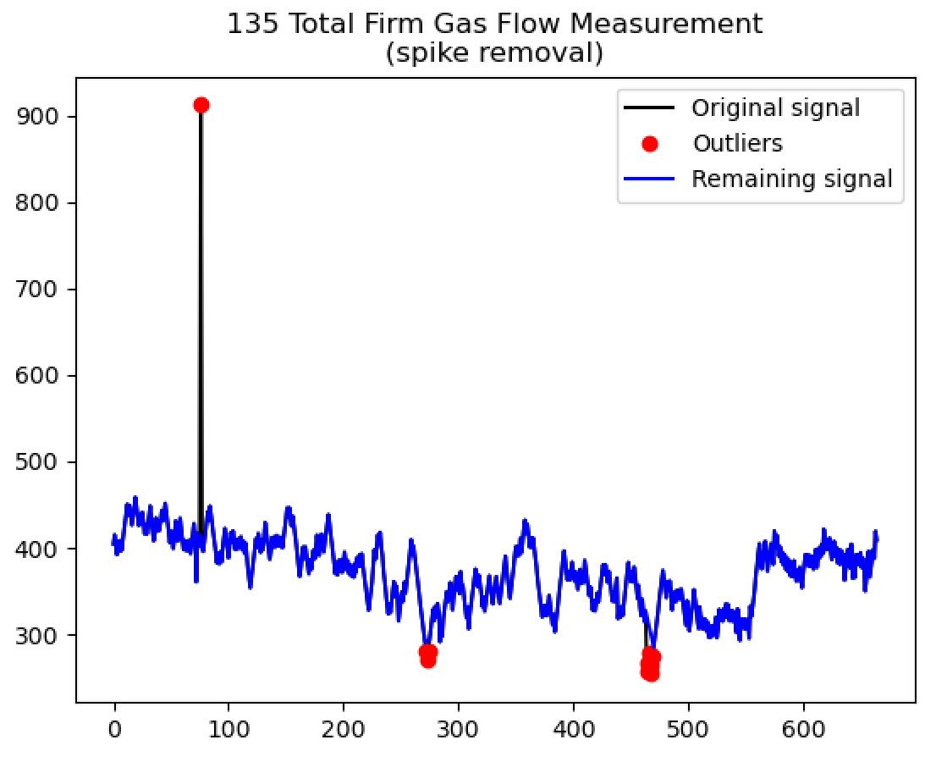
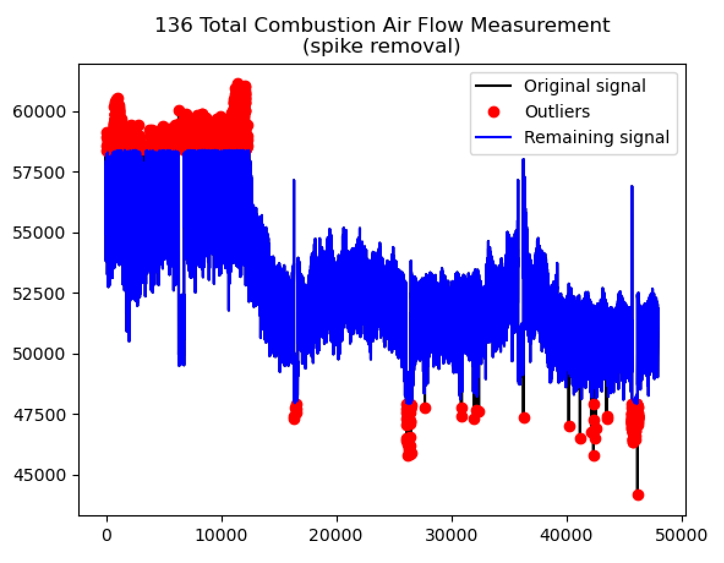

Slide 7
Tag data processing pipeline (2)
Does it require low-pass filtering?
Contains spikes?
no
no
no
Interpolation
Standardise
Time lags
Reversal?
yes
yes
yes
Remove spikes
Filter

Slide 8
Tag data processing pipeline (2)
Does it require low-pass filtering?
Contains spikes?
no
no
no
Interpolation
Reversal?
yes
yes
yes
High pass filter
Remove spikes
Filter
Standardise
Time lags

Slide 9
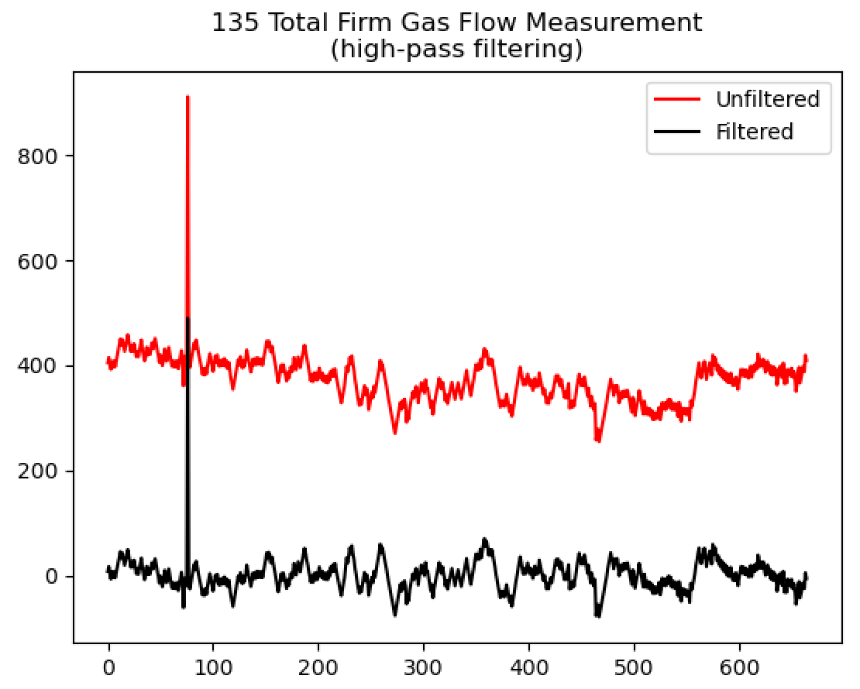
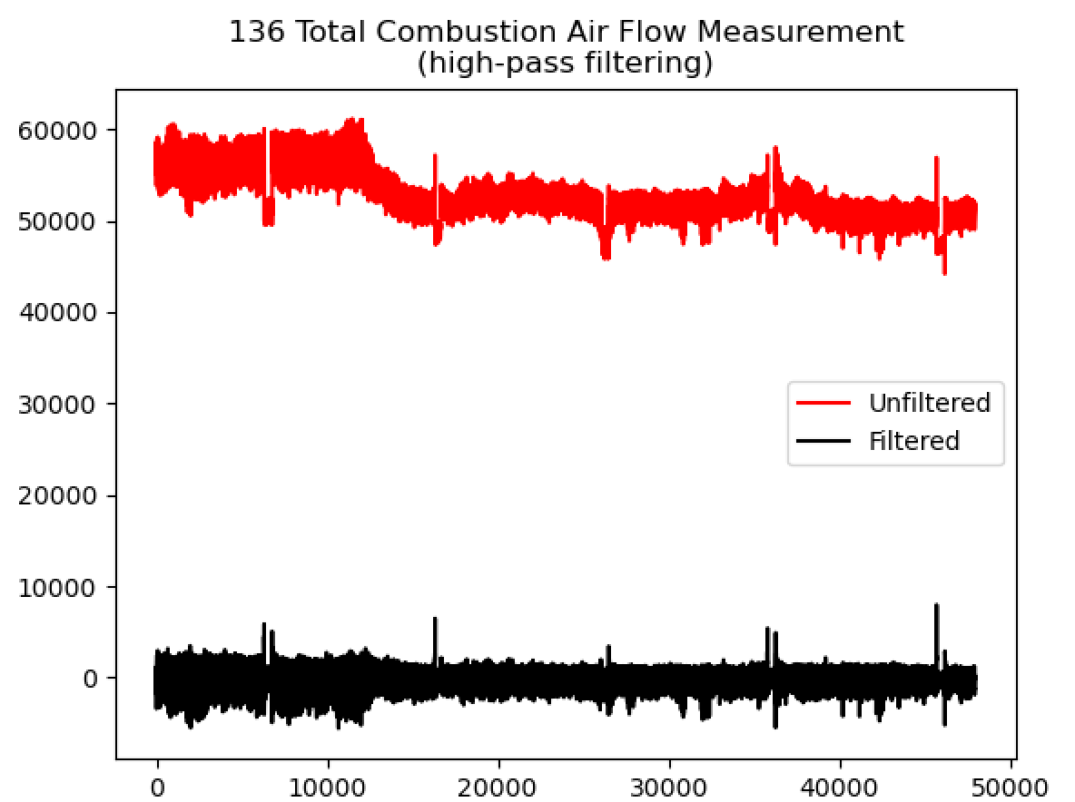
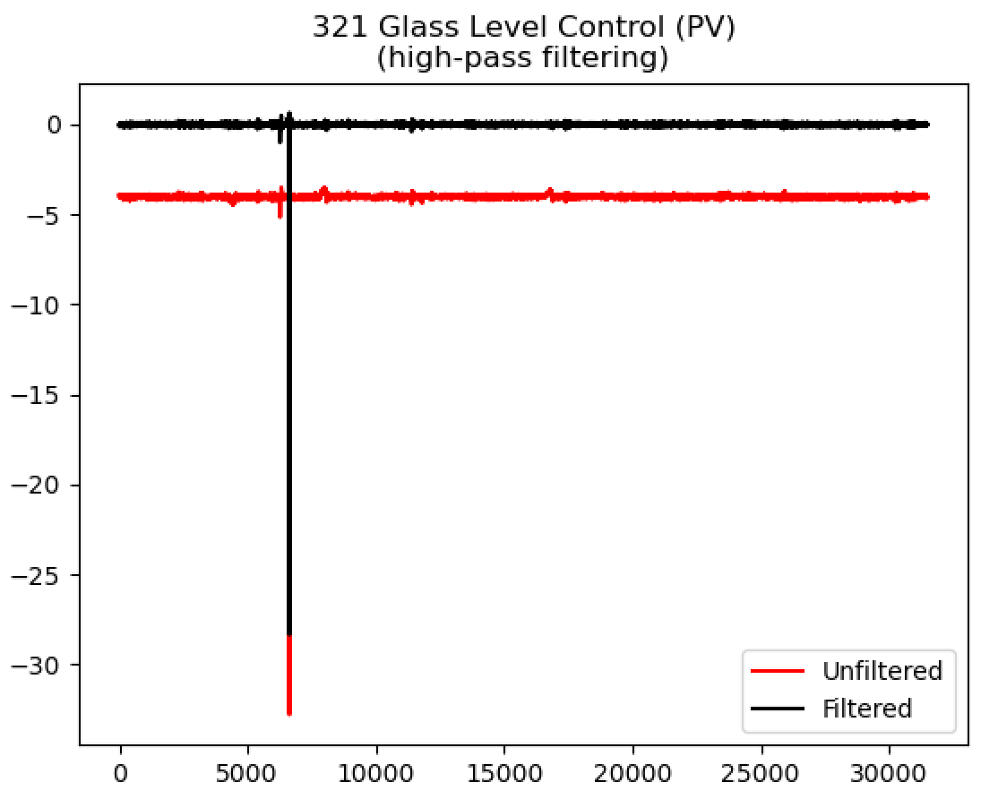
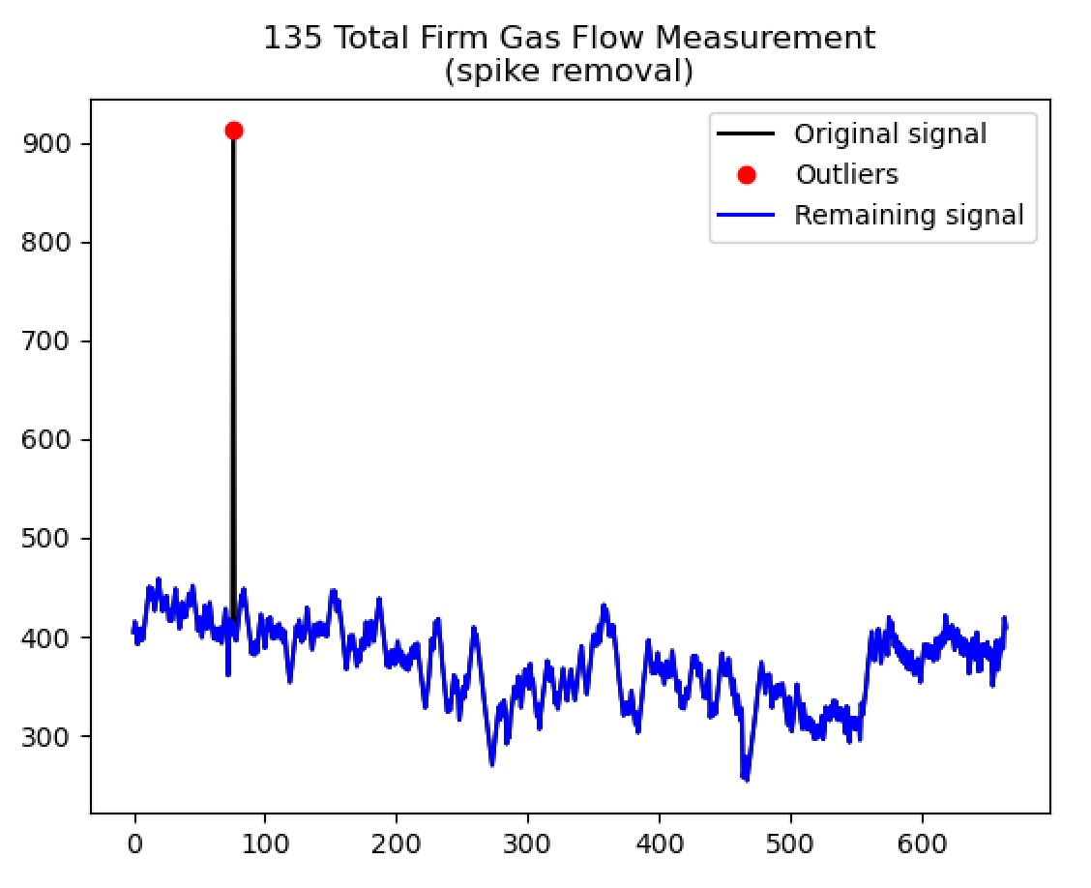
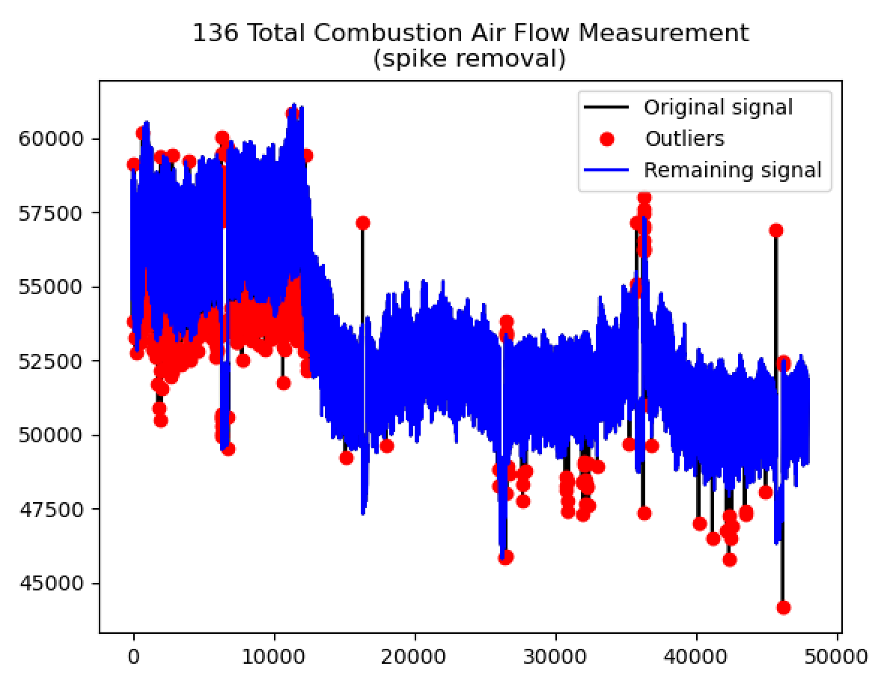
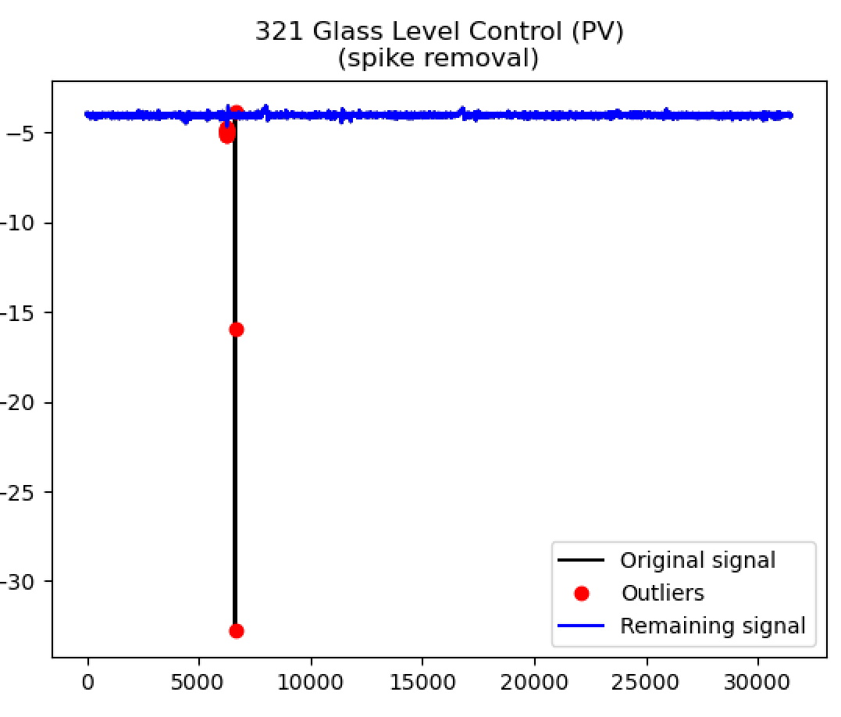
(Need to tweak filter parameters)

Slide 10
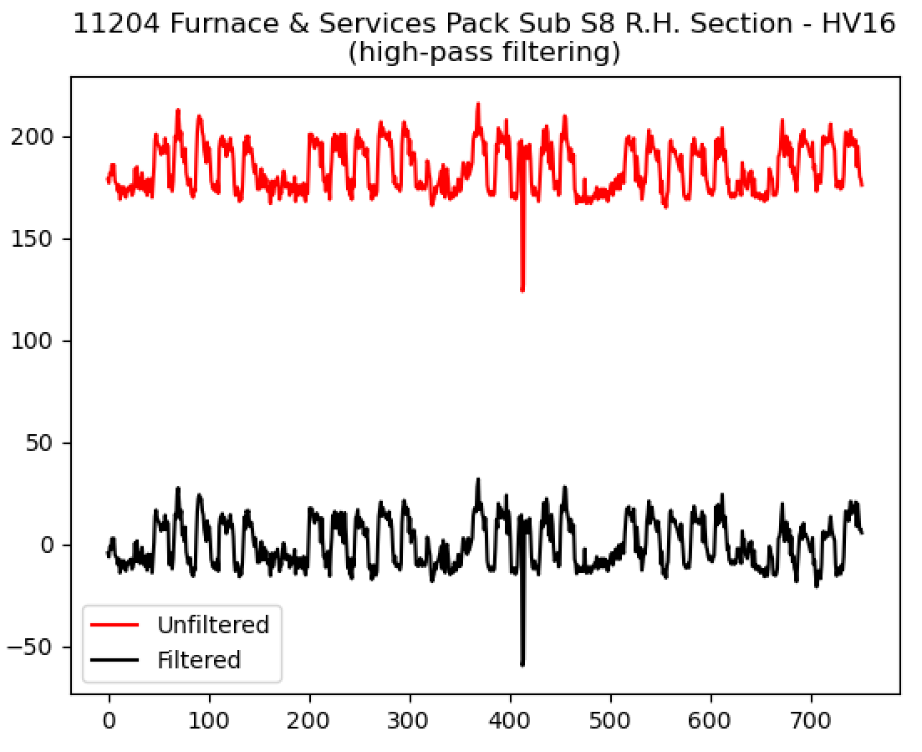
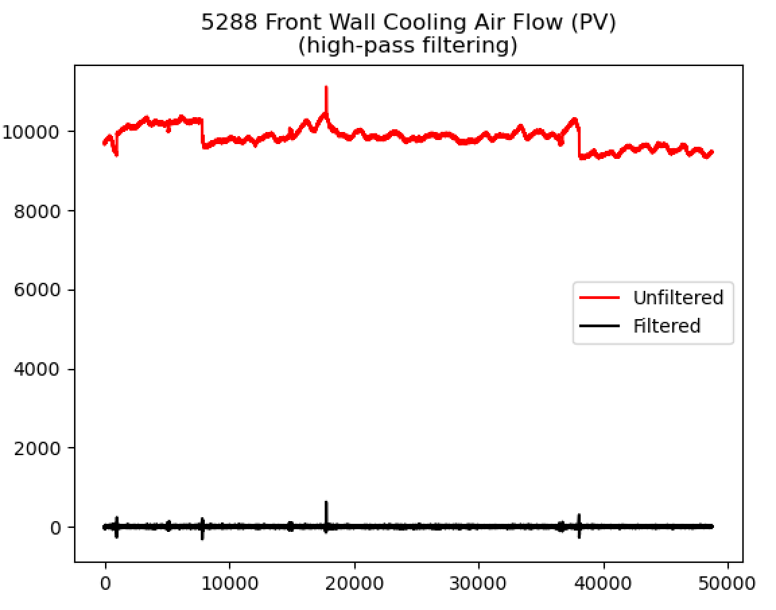
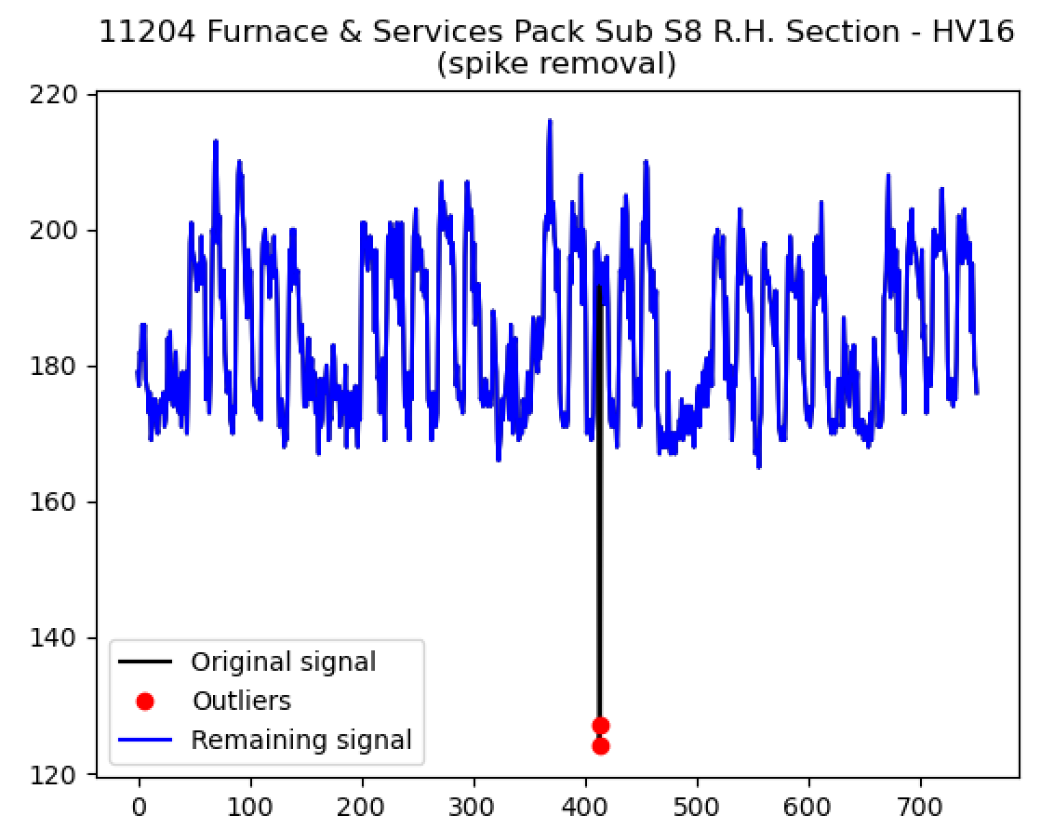
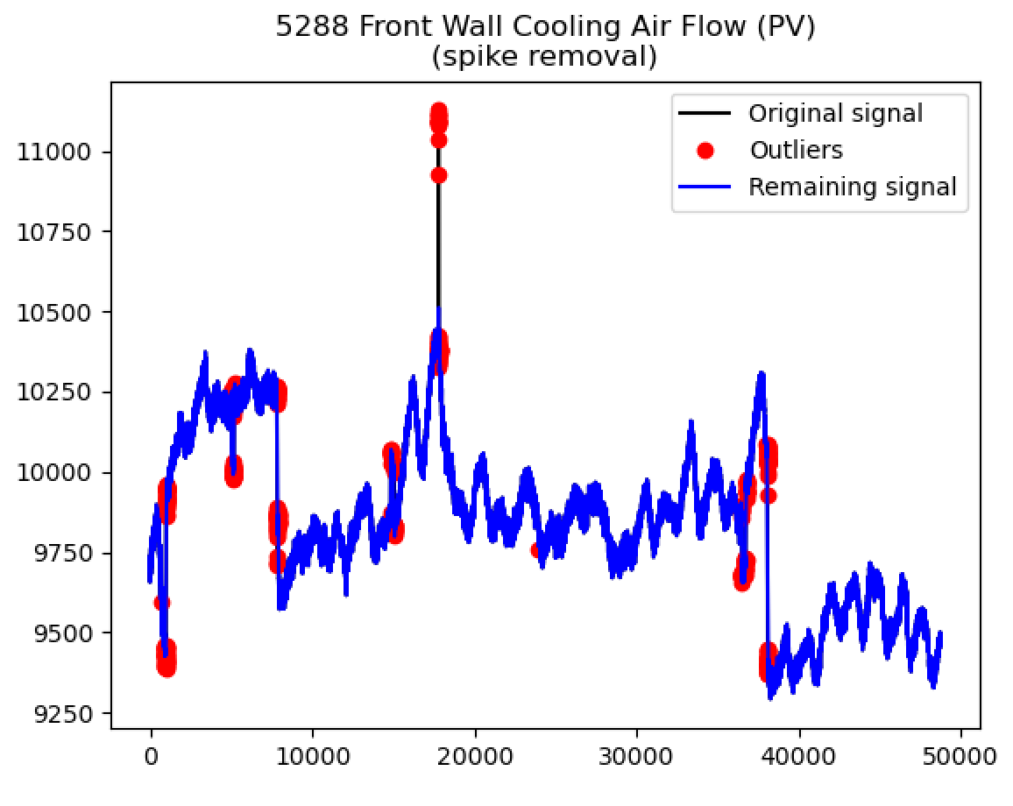
(Need to tweak filter parameters)

Slide 11
Furnace faults processing pipeline
High pass filter
Remove spikes
Low-pass filtering

Slide 12
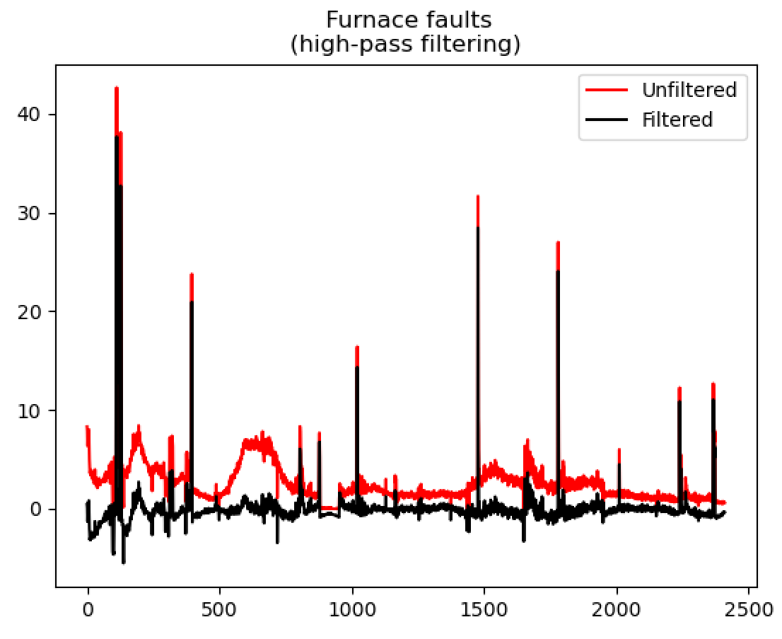
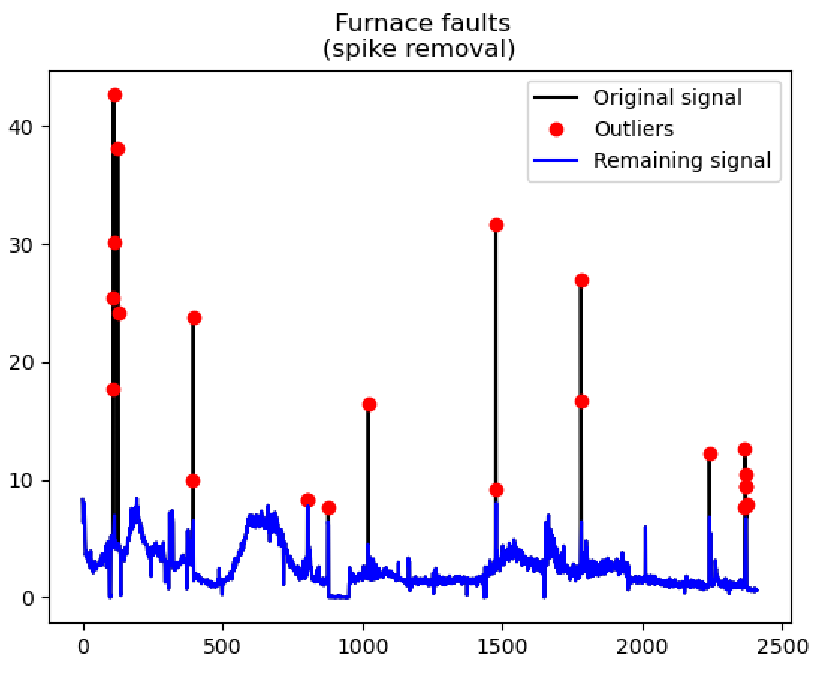
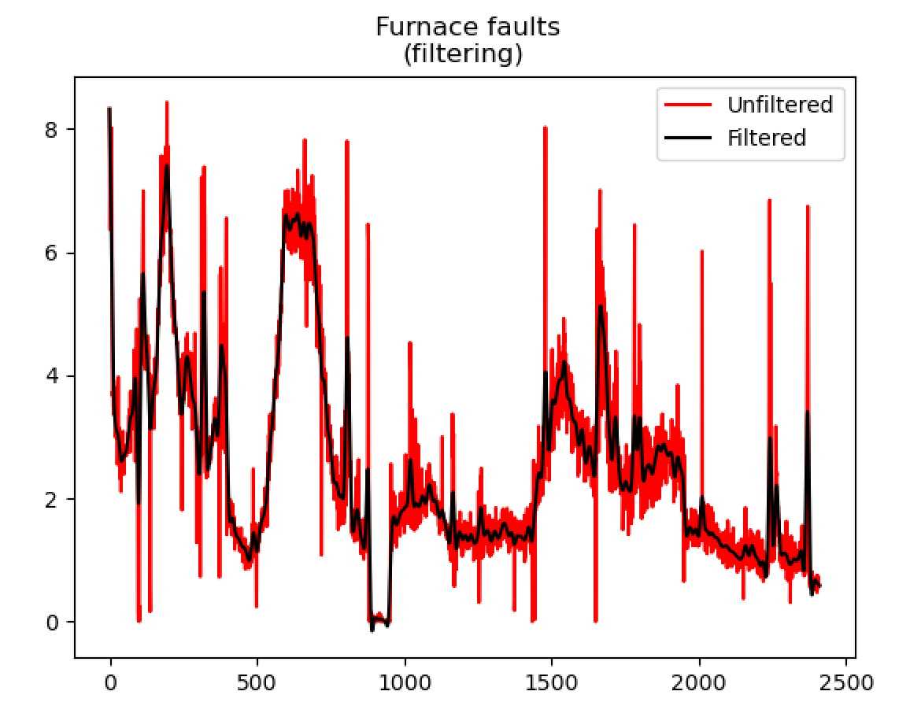
Furnace faults processing pipeline
High pass filter
Remove spikes
Low-pass filtering

Slide 13
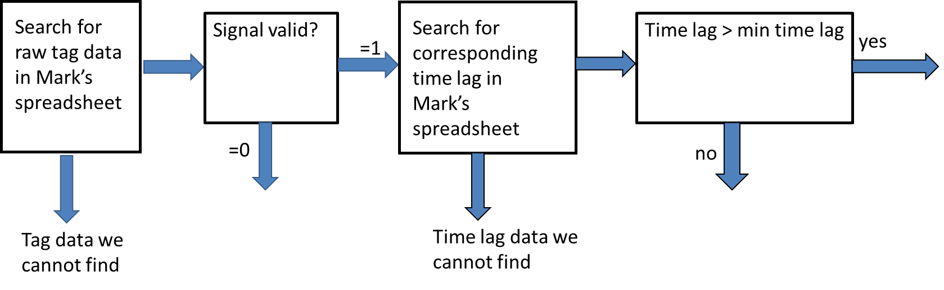
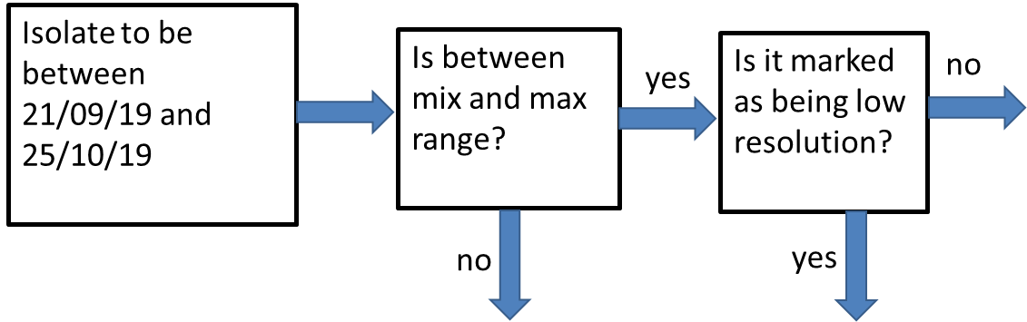
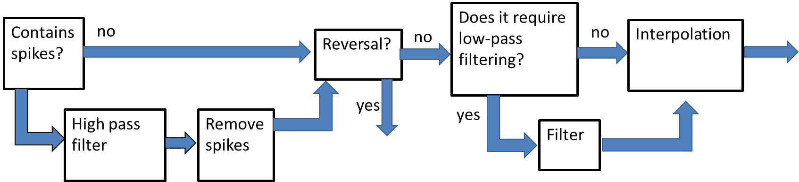
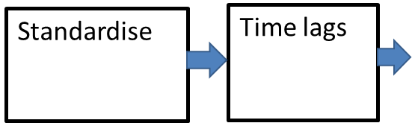
Tests
Data pipeline 1
Data pipeline 1
Data pipeline 3

Slide 14
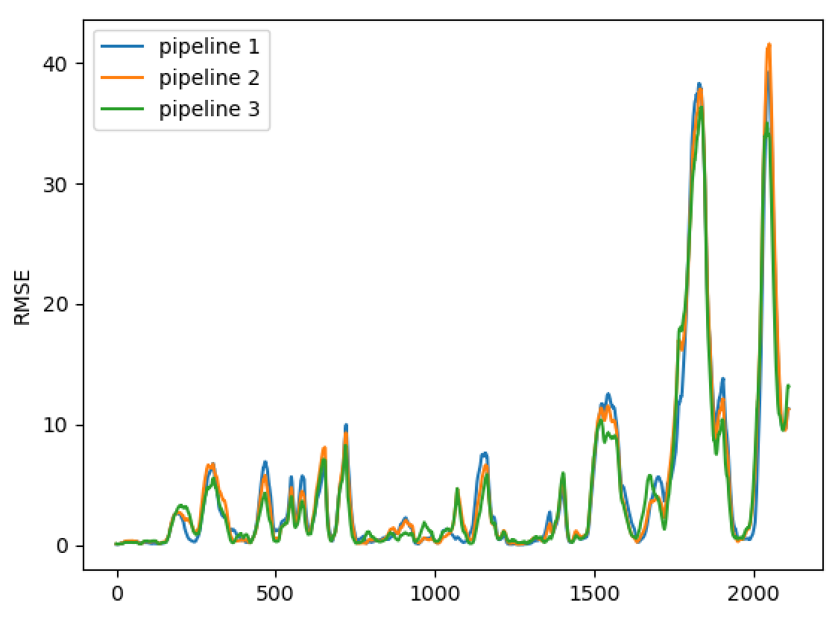
Tests
Pipeline | Av. RMSE
1 | 4.59
2 | 4.70
3 | 4.31
Inclusion of ‘reversal data’, even unprocessed, has improved model performance. Sensible processing of this data will be a key next step.

Slide 15
To-do (short-term)
Currently no time lags associated with campaign data.
Need bespoke filtering for some of the signals (we can do this with an extra column in the spreadsheet).
Some of the data outside of ‘eng min-max’ need to be processed and included in the data pipeline.
To-do (longer-term)
Establish and implement strategy for processing data that is affected by reversals.
Repeat analysis that use randomly selected inputs and/or randomly selected time lags.

